Slide 1
Exam Objective
pandas Foundations
Import many types of datasets and deal with import issues Export data to facilitate collaborative data science Perform statistical and visual EDA natively in pandas

Slide 2
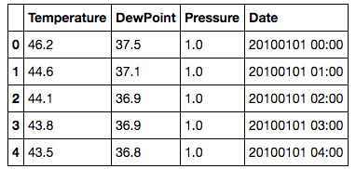
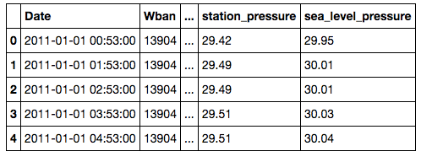
Data Sources
pandas Foundations
●
Comparing observed weather data from two sources
Source: National Oceanic & Atmospheric Administration, www.noaa.gov/climate

Slide 3
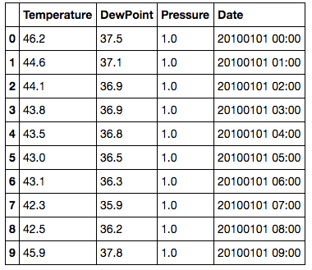
Climate normals of Auburn, AL from 1981-2010
pandas Foundations
Source: National Oceanic & Atmospheric Administration, www.noaa.gov/climate

Slide 4
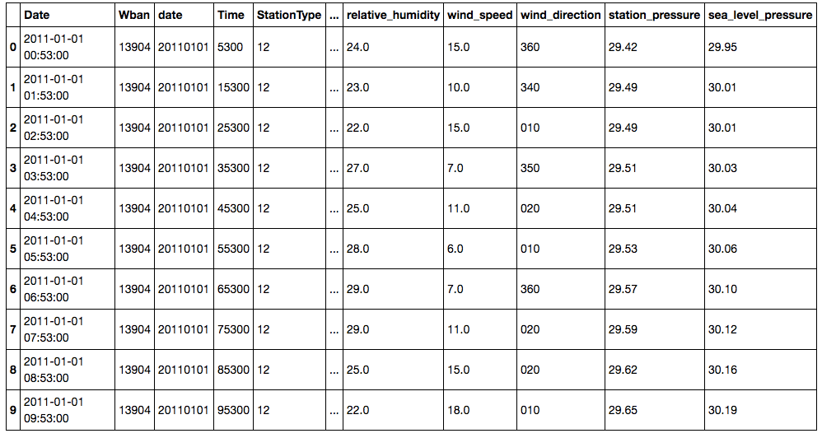
Weather data of Auburn, AL from 2011
pandas Foundations
Source: National Oceanic & Atmospheric Administration, www.noaa.gov/climate

Slide 5
Reminder: read_csv()
pandas Foundations
●
Useful keyword options
●
names: assigning column labels index_col: assigning index parse_dates: parsing datetimes na_values: parsing NaNs
●
●
●

Slide 6
Exploratory data analysis

Slide 7

Reminder: time series
pandas Foundations
●
Index selection by date time Partial datetime selection Slicing ranges of datetimes
●
●
In [1]: climate2010['2010-05-31 22:00:00'] # datetime In [2]: climate2010['2010-06-01'] # Entire day
In [3]: climate2010['2010-04'] # Entire month
In [4]: climate2010[‘2010-09':'2010-10'] # 2 months

Slide 8
Reminder: statistics methods
pandas Foundations
●
Methods for computing statistics:
●
describe(): summary mean(): average
count(): counting entries median(): median
std(): standard deviation
●
●
●
●

Slide 9
Visual exploratory data analysis

Slide 10
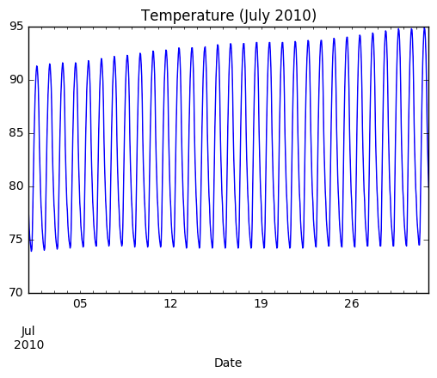
Line plots in pandas
pandas Foundations

Slide 11
Line plots in pandas
pandas Foundations
In [1]: import matplotlib.pyplot as plt
In [2]: climate2010.Temperature['2010-07'].plot()
In [3]: plt.title('Temperature (July 2010)')
In [4]: plt.show()

Slide 12
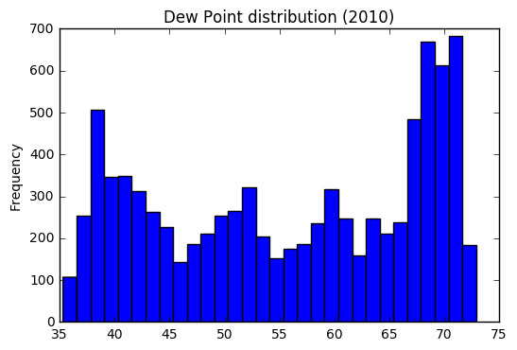
Histograms in pandas
pandas Foundations

Slide 13
Histograms in pandas
pandas Foundations
In [5]: climate2010['DewPoint'].plot(kind= 'hist', bins=30) In [6]: plt.title('Dew Point distribution (2010)')
In [7]: plt.show()

Slide 14
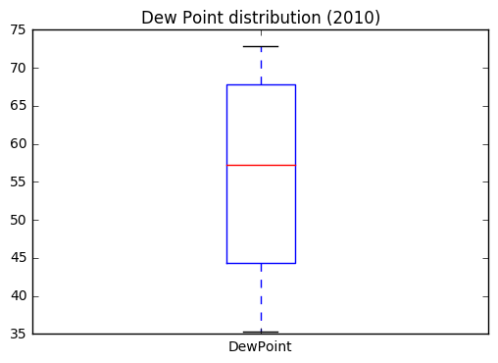
Box plots in pandas
pandas Foundations

Slide 15
Box plots in pandas
pandas Foundations
In [8]: climate2010['DewPoint'].plot(kind='box')
In [9]: plt.title('Dew Point distribution (2010)')
In [10]: plt.show()

Slide 16
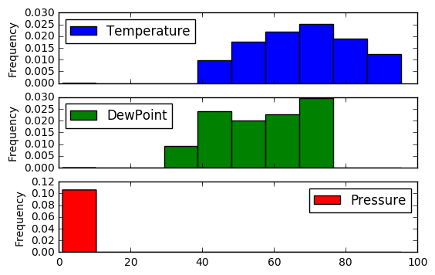
Subplots in pandas
pandas Foundations

Slide 17
Subplots in pandas
pandas Foundations
In | [11]: | climate2010.plot(kind='hist', | normed=True, | subplots=True)
In | [12]: | plt.show()

